Slide 1

Automatic Detection of Parkinson’s Disease Using Gait Signals
Saranya Bhattacharjee (aj81owid)
MSc Artificial Intelligence
Project Time Series, Pattern Recognition Lab
Supervisor: Dr.-Ing. Tomás Arias-Vergara

Slide 2
Talk Overview:
Introduction & Motivation
Related Work
Dataset Overview and Analysis: PhysioNet
TSFresh-Feature Extraction and PCA Preparation Pipeline
PCA Visualization of Extracted Gait Features
Machine Learning Framework
Results & Key Findings
Conclusions, Limitations & Future Work
Q&A

Slide 3
Introduction and Motivation
Parkinson's Disease · Automated Gait Analysis
10M+
2nd
UPDRS
vGRF
People affected worldwide
Most common neurodegenerative disorder
Subjective clinical rating scale
Objective gait biomarker
WHY AUTOMATE PD DETECTION?
Motor symptoms are measurable
Tremor, bradykinesia & instability directly alter gait force patterns
Clinical assessment is subjective
UPDRS scores vary by examiner — automated biomarkers reduce variability
vGRF signals are accessible
Force plates & wearables enable scalable, non-invasive PD screening
Research Question
"Can TSFresh-derived bilateral gait features reliably distinguish PD patients from healthy controls using classical ML classifiers?"

Slide 4
Related Work
Existing Approaches to PD Detection from Gait
Handcrafted Features + Classical ML
Unilateral / Per-Sensor Analysis
Ensemble ML, No Rigorous Validation
SIGNAL
Single trunk IMU (lower back, L5)
SIGNAL
Pressure insole + IMU, evaluated per sensor independently
SIGNAL
PhysioNet vGRF — same dataset
(166 subjects)
FEATURES
7 hand-picked — stride time,
cadence, pelvic kinematics, stability indexes.
FEATURES
Spatiotemporal gait parameters per
leg separately
FEATURES
Hypertuned RF + Ensemble
ACCURACY
>80% RF — single sensor only
ACCURACY
86% — but no nested CV;
conflates binary classification
with severity regression
Not directly reported for binary
PD vs HC
ACCURACY
Manual feature selection — no bilateral foot signal; multicollinearity risk; not reproducible across datasets
[1] Trabassi et al. (Sensors, 2022).
Bilateral gait asymmetry not captured — sensors evaluated independently, no cross-foot coordination modelled.
[2] Tsakanikas et al. (Sensors, 2023).
Results not comparable to subject-level binary classification; optimistic estimate without unbiased validation
[3] Navita et al. (Scientific Reports, 2025).
THIS WORK
TSFresh comprehensive features on bilateral vGRF → automated descriptors (autocorrelation, entropy, energy, RMS) → RF & SVM classifiers with nested CV → rigorous, interpretable baseline for future Mamba / SSM comparison
[1] Trabassi, D. et al. (2022). "Machine Learning Approach to Support the Detection of Parkinson's Disease in IMU-Based Gait Analysis." Sensors, 22(10), 3700.
[2] Tsakanikas, V. et al. (2023). "Evaluating Gait Impairment in Parkinson's Disease from Instrumented Insole and IMU Sensor Data." Sensors, 23(8), 3902..
[3] Navita et al. (2025). "Gait-Based Parkinson's Disease Diagnosis and Severity Classification Using Force Sensors and Machine Learning." Scientific Reports.

Slide 5
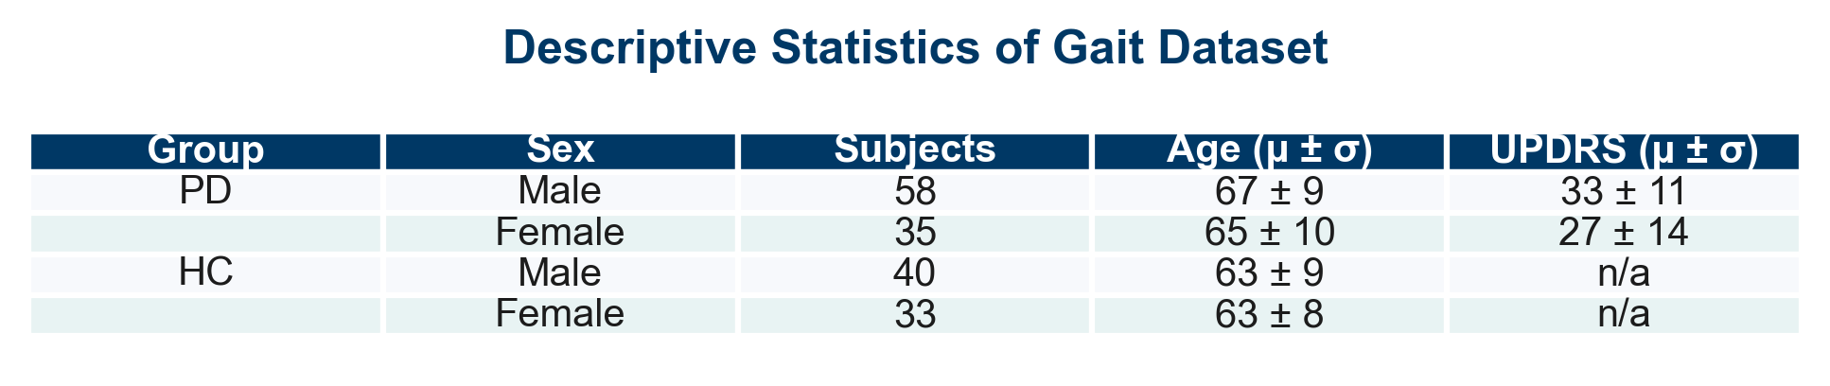
Dataset Overview: PhysioNet
Gait in Parkinson’s Disease Database (166 subjects — 93 PD, 73 healthy controls)
Contains vertical ground reaction force (vGRF) signals from 8 sensors per foot (16 total channels).
Recording duration: ~2 minutes of natural walking on an 8-force-plate walkway.
Sampling frequency: 100 Hz (≈ 12 000 samples per foot, ≈ 24 000 total per subject).
Clinical evaluation: Unified Parkinson’s Disease Rating Scale (UPDRS) for PD subjects.
Higher UPDRS scores indicate greater motor symptom severity.
Only usual-walking trials (‘01’) were used to ensure consistent gait conditions.

Slide 6
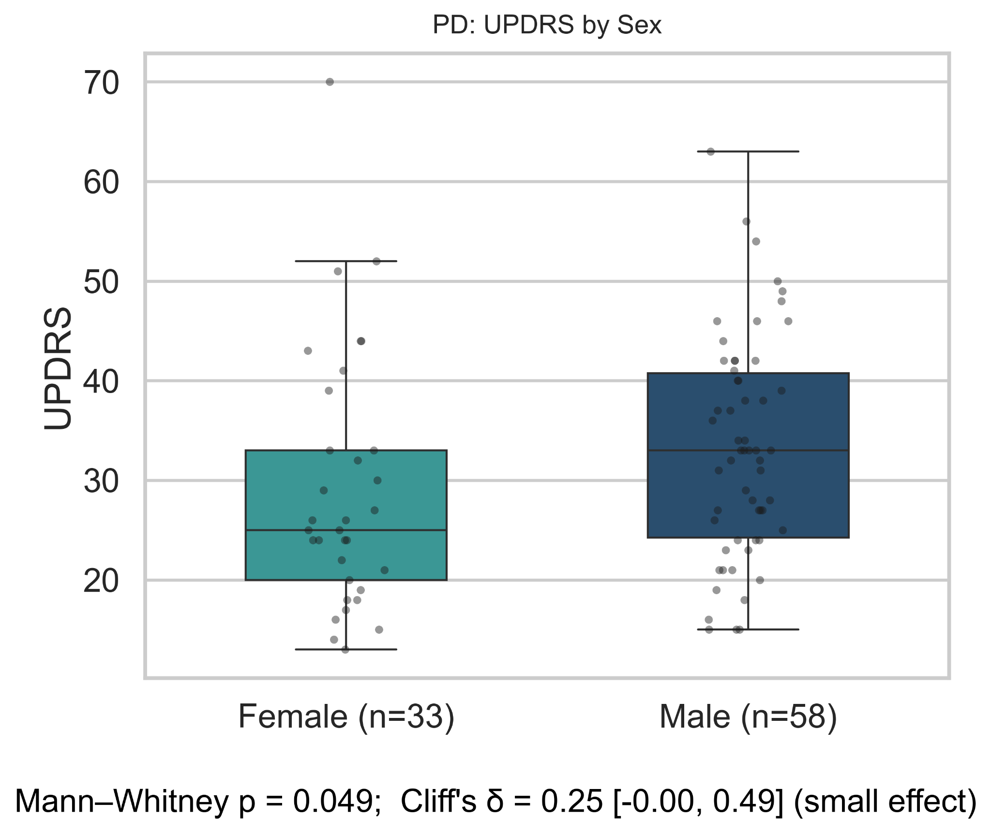
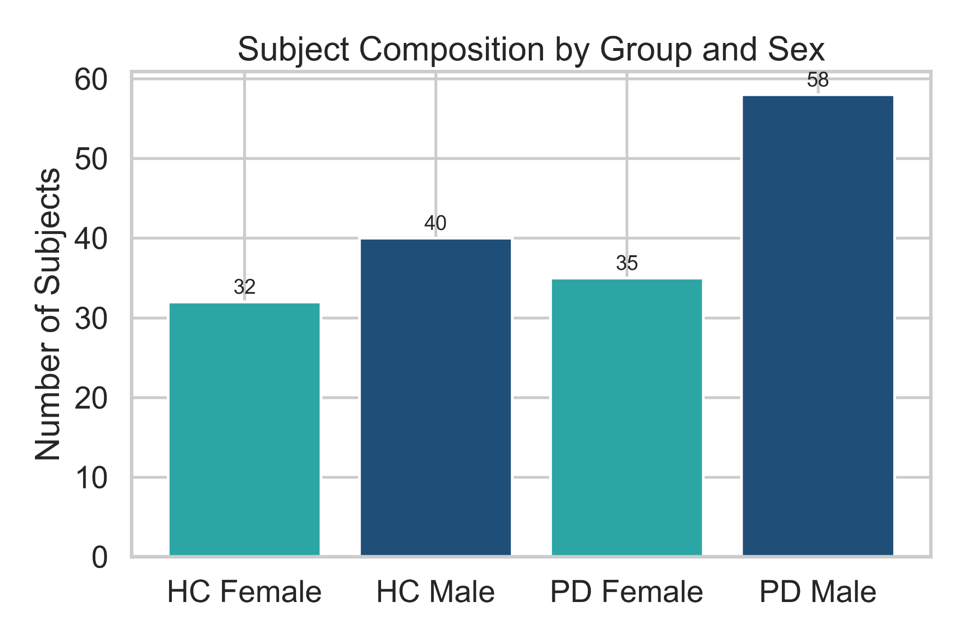
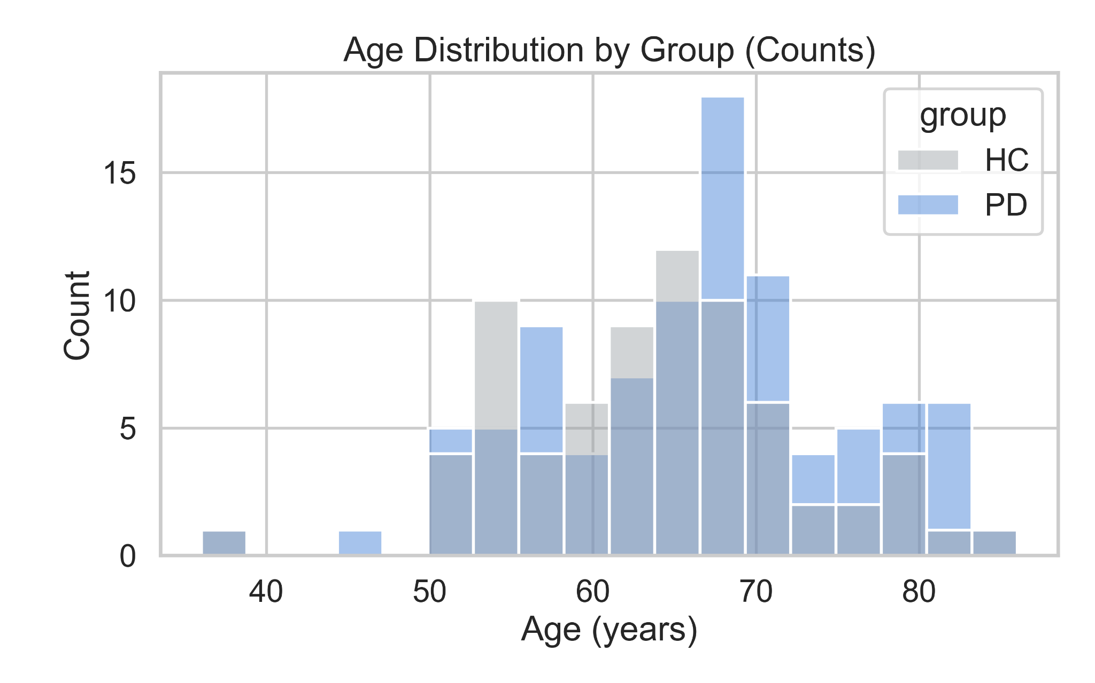
Dataset Overview: PhysioNet
Gait in Parkinson’s Disease Database (166 subjects — 93 PD, 73 healthy controls)
Balanced dataset with slightly higher representation of male PD participants.
PD and HC groups are closely age-matched, minimizing demographic confounds.
Male PD patients show slightly higher UPDRS scores and greater variability than females (p = 0.049; Cliff’s δ = 0.25, small effect), indicating marginally stronger motor impairment.

Slide 7
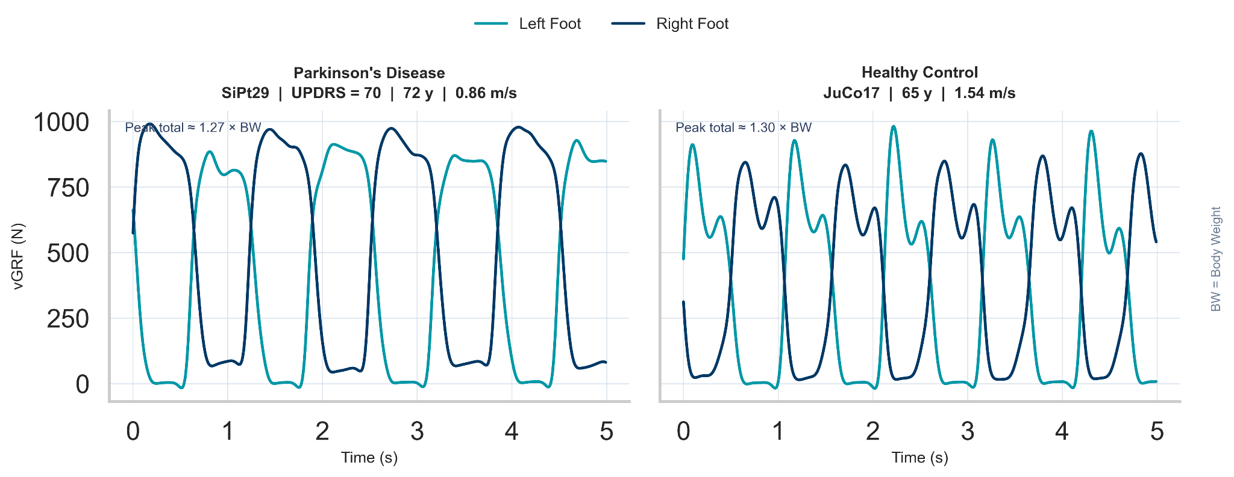
Example Vertical Ground Reaction Forces (vGRF) Cycles : Parkinson’s Disease vs Healthy Control
5-seconds segment sampled at 100 Hz (8 sensors per foot) - Usual walking (walk 01)
PD gait shows lower peak force, greater inter-limb asymmetry and less stable stance than HC.
Notes:
Parkinson’s Disease (SiPt29, UPDRS = 70, 72 y, 0.86 m/s): Lower peak vGRF (near 1.27 × BW) and greater inter-limb asymmetry indicate reduced push-off force and impaired stance control, typical of bradykinetic gait.
Healthy Control (JuCo17, 65 y, 1.54 m/s): Balanced, rhythmic vGRF cycles with peaks near 1.30 × BW reflect stable gait rhythm and efficient weight transfer between limbs.
Observation: PD subject shows less consistent inter-limb timing and lower load transfer efficiency than HC, consistent with postural instability and reduced propulsion.

Slide 8
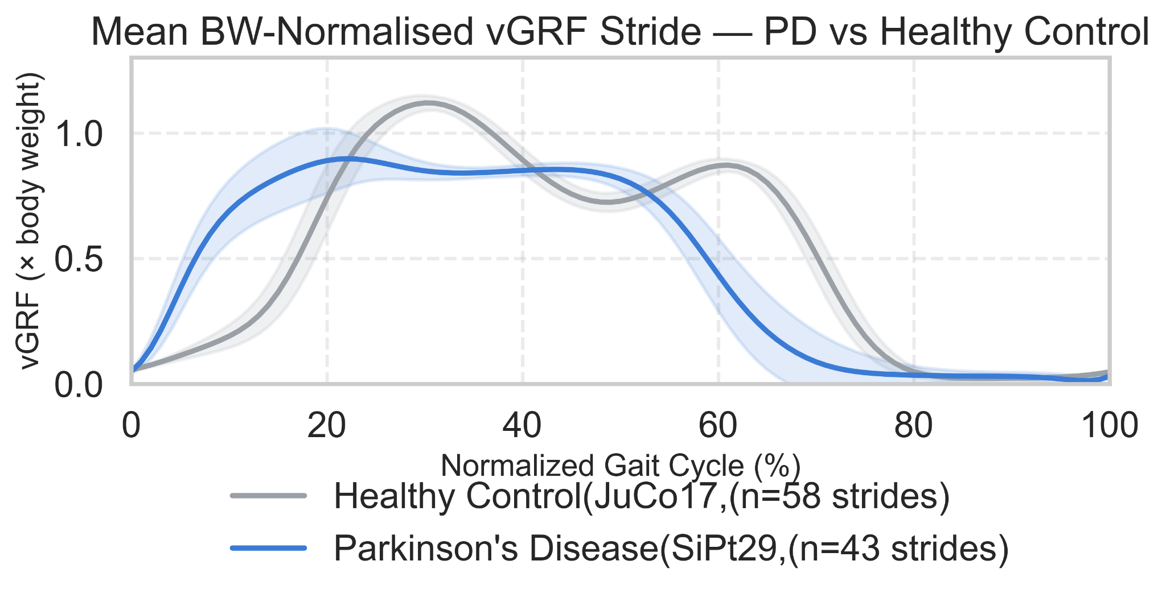
Mean Normalized vGRF Stride Comparison: Parkinson’s Disease vs Healthy Control
Normalized across 0–100% gait cycle, right foot (SiPt29 vs JuCo17)
PD subject (SiPt29) shows lower and flatter vGRF throughout the stride → reduced loading and propulsion.
Healthy Control (JuCo17) retains the two-peak pattern (heel strike + push-off) → rhythmic, symmetric gait.
PD displays merged peaks and greater variability (20–80 %) → unstable stance control.
Overall: PD gait = less amplitude, less symmetry, less efficiency.
Mean ± 1 SD across detected cycles per subject.
n denotes the number of detected gait cycles per subject used to compute the mean ± 1 SD curves.

Slide 9
Feature Extraction and PCA Preparation Pipeline
Transforming raw vGRF signals into normalized, subject-level feature representations suitable for dimensionality-reduction analysis.
1 Signal
Composition
16-channel vGRF file reduced to 2 signals
8 load-cell sensors per foot summed → total vGRF per foot (N)
Low-pass Butterworth filter at 6 Hz (filtfilt) — preserves gait harmonics
1
2 Windowing
Sliding window segmentation per signal
300 ms window (30 samples at 100 Hz) · 150 ms step
2
3 Feature
Extraction
TSFresh ComprehensiveFCParameters per window
Descriptors: autocorrelation, energy, entropy, RMS, FFT peaks
Applied separately for Left foot and Right foot
3
4 Statistical
Aggregation
Per subject × foot across all windows
Mean · Std Dev · Skewness · Kurtosis
Produces one feature vector per subject per foot
4
5 Normalisation
Z-score normalisation column-wise
Removes scaling bias before PCA
5
6 Feature Set
Variants
Three feature matrices built
Left foot only · Right foot only · Combined (L + R concatenated)
6
Output Subject-level feature matrices (Left / Right / Combined) → PCA visualisation + classification

Slide 10
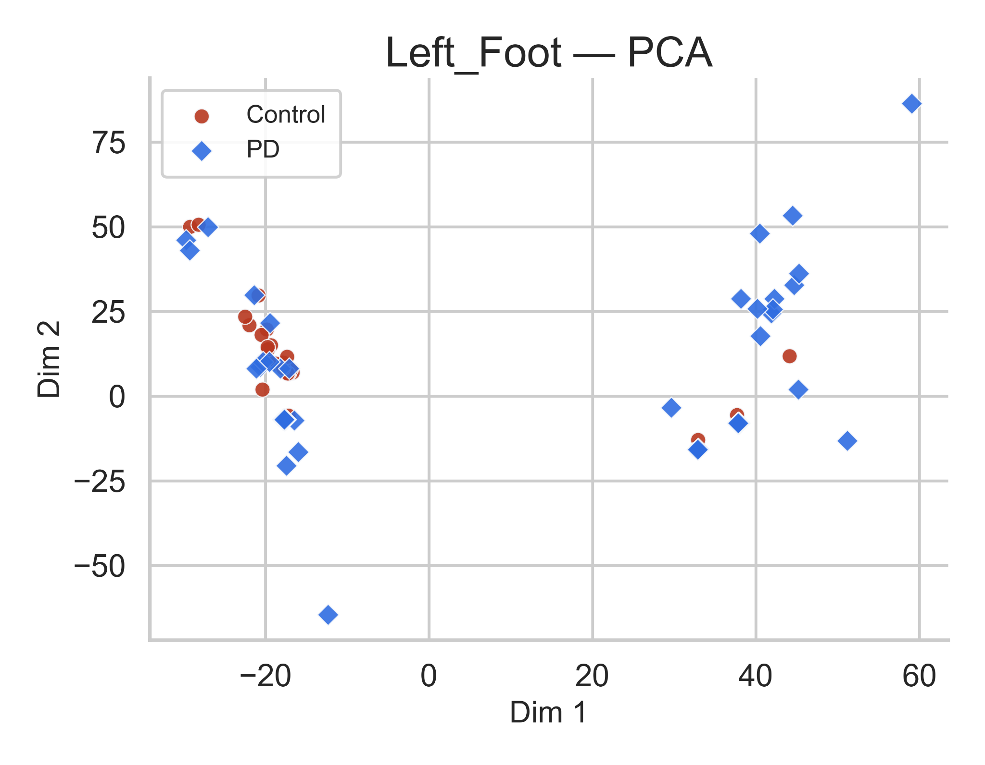
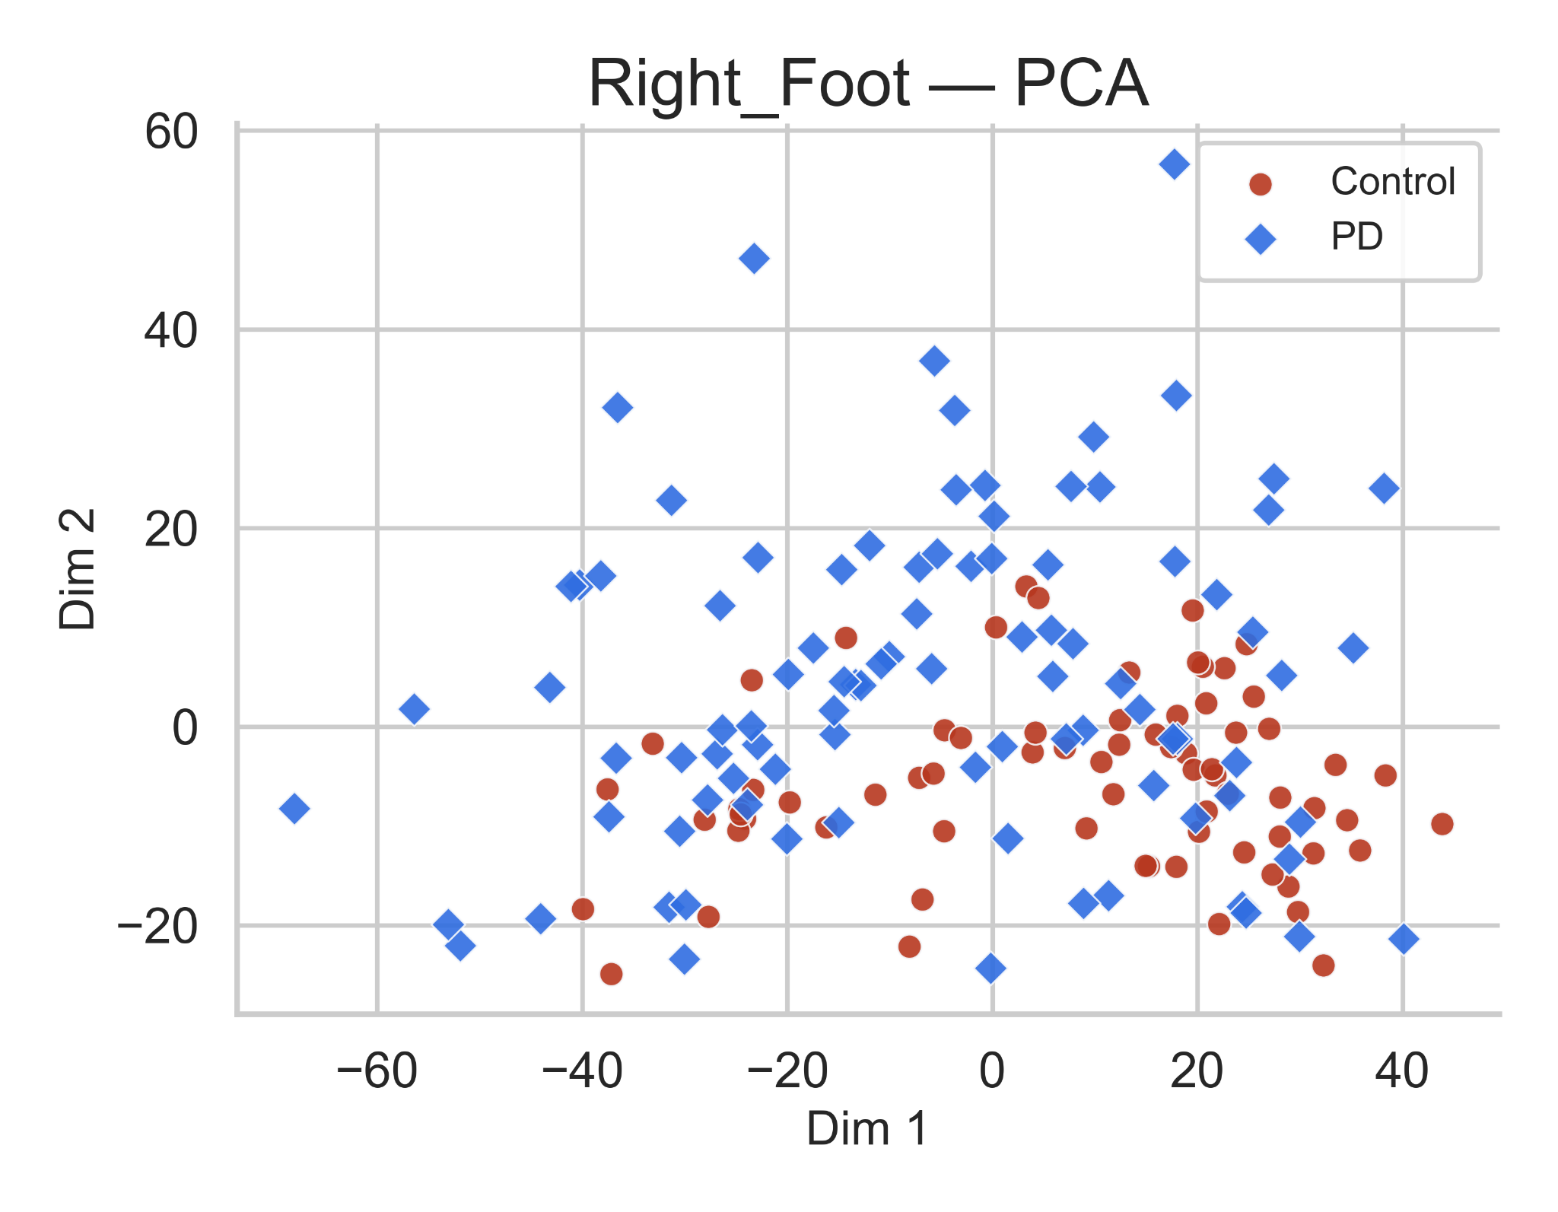
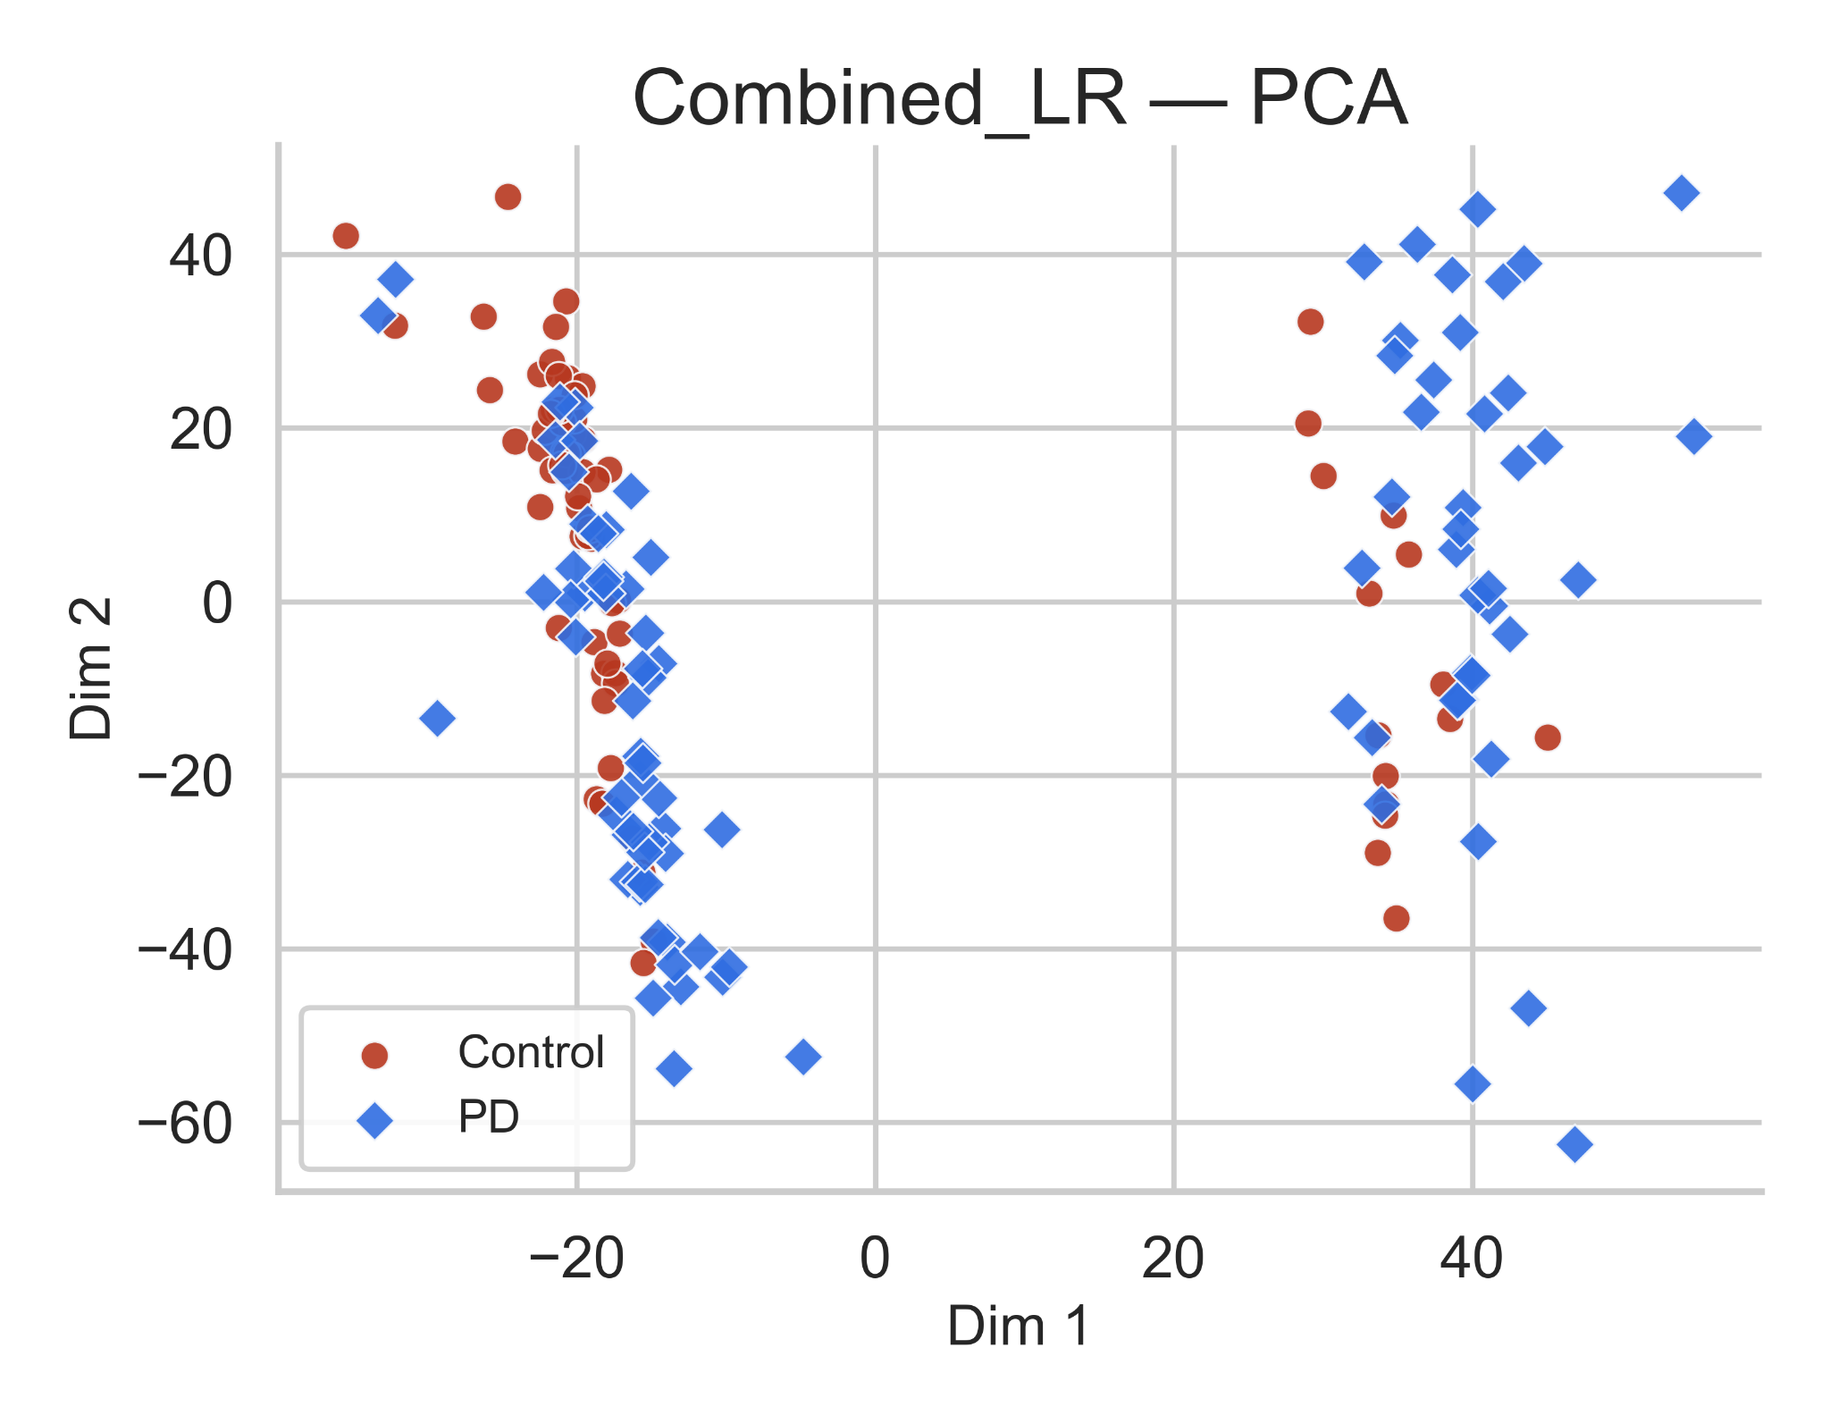
PCA Visualization of Extracted Gait Features
Evaluating the variance structure of TSFresh features based on vGRF signals.
PD subjects are more spread out than controls → showing higher variability and less stable force control.
This could be linked to differences in how the affected side supports weight.
Here, both groups overlap quite a bit.
The right-foot features don’t show a clear difference, maybe because some PD participants use this side to compensate while walking.
When both feet are combined, the groups separate more clearly → capturing left–right coordination differences and overall gait asymmetry.
Takeaway: Left shows variability, right shows compensation, and combining both sides best highlights Parkinsonian gait asymmetry.

Slide 11
Baseline Machine Learning Pipeline
Feature Matrix → StandardScaler → PCA → GridSearchCV → Evaluation
1 INPUT
TSFresh features — Left / Right / Combined
Already aggregated at subject level
DESIGN DECISIONS AND WHY
Nested CV (not simple holdout)
n=166 is too small. Simple CV gives optimistic estimates; nested separates tuning from evaluation.
2 STRATIFIED CV
Outer: 5-fold — balanced PD / HC per fold
Inner: 3-fold GridSearchCV per fold
StandardScaler inside each fold
Fitting on full data before split leaks test statistics into training.
3 STANDARDSCALER
Z-score normalisation fitted on train fold only
Prevents information leakage to test fold
PCA after scaling
4 PCA
Fitted per fold on training data only
Retains components explaining ~95% variance
PCA is sensitive to feature scale so scaling must come first. Fitted per fold to avoid leakage
ROC-AUC as tuning criterion
5 MODEL TRAINING
Random Forest · SVM-Linear · SVM-RBF
Grid search selects best hyperparameters via ROC-AUC
AUC is threshold-independent.
3 classifiers compared
6 EVALUATION
Per fold: Accuracy · Sensitivity · Specificity · AUC
Reported as Mean ± STD across 5 folds
RF captures non-linear interactions. SVM-Linear tests linear separability. SVM-RBF tests non-linear boundary.
Subject-level aggregation
7 FINAL OUTPUT
Out-of-fold predictions aggregated across all 5 outer folds
Confusion matrices computed from pooled held-out predictions
Window-level evaluation inflates accuracy. One subject contributes hundreds of windows causing leakage.

Slide 12
Cross-Validated Performance (Fold-wise Metrics)
Baseline Model Performance (Mean ± Std Across 5 Folds)
Dataset | Model | Accuracy (±SD) | Sensitivity (±SD) | Specificity (±SD) | AUC (±SD)
Left | Random Forest | 0.64 ± 0.07 | 0.75 ± 0.11 | 0.49 ± 0.11 | 0.68 ± 0.05
 | SVM (Linear) | 0.64 ± 0.08 | 0.83 ± 0.07 | 0.40 ± 0.09 | 0.62 ± 0.11
 | SVM (RBF) | 0.67 ± 0.07 | 0.89 ± 0.11 | 0.45 ± 0.24 | 0.65 ± 0.05
Right | Random Forest | 0.69 ± 0.04 | 0.83 ± 0.07 | 0.52 ± 0.13 | 0.76 ± 0.08
 | SVM (Linear) | 0.67 ± 0.05 | 0.78 ± 0.10 | 0.54 ± 0.11 | 0.75 ± 0.07
 | SVM (RBF) | 0.72 ± 0.05 | 0.76 ± 0.05 | 0.65 ± 0.13 | 0.78 ± 0.05
Combined | Random Forest | 0.73 ± 0.03 | 0.82 ± 0.08 | 0.62 ± 0.06 | 0.85 ± 0.07
 | SVM (Linear) | 0.75 ± 0.04 | 0.75 ± 0.07 | 0.75 ± 0.11 | 0.82 ± 0.06
 | SVM (RBF) | 0.78 ± 0.05 | 0.78 ± 0.09 | 0.72 ± 0.11 | 0.85 ± 0.04

Slide 13
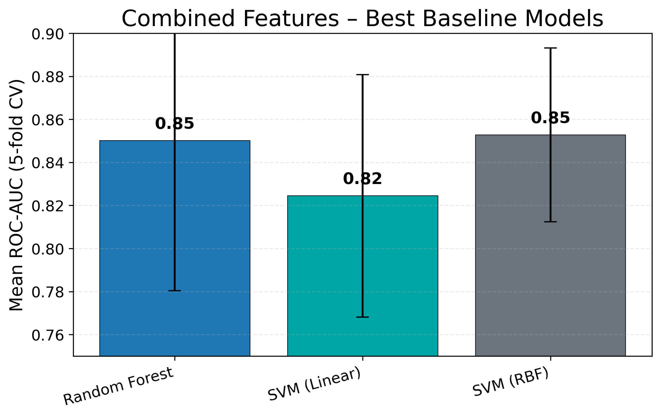
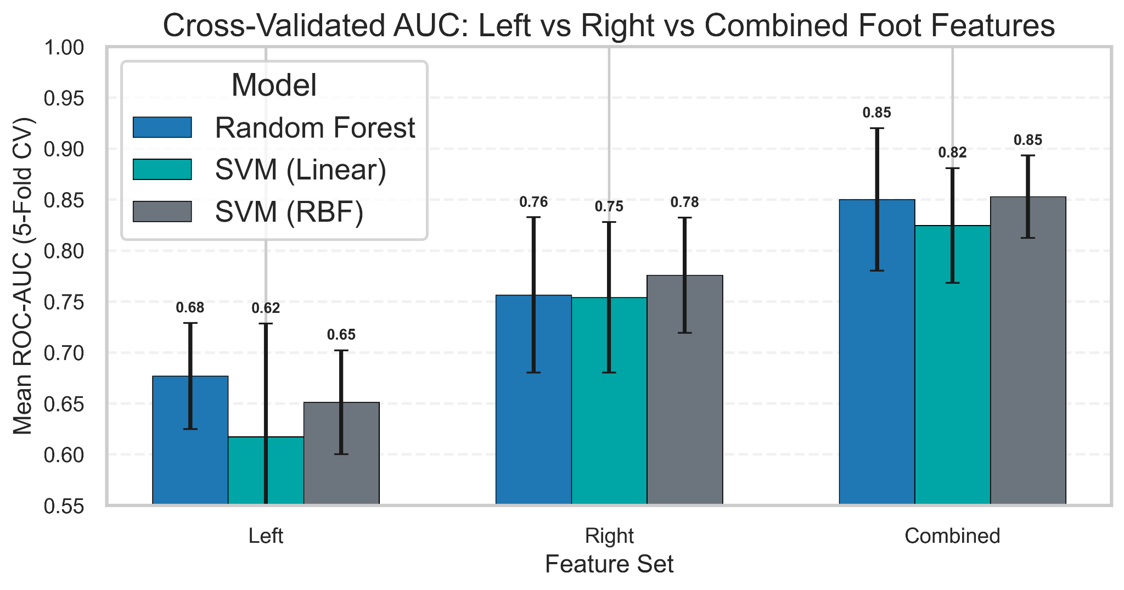
Best Performing Baseline Models (Highlights)
Combined TSFresh features with SVM-RBF/Random Forest yield strong baseline AUC (~0.84–0.85), clearly outperforming single-foot models.
Combined features yield the best baselines; RF and SVM-RBF: both at 0.85 AUC.
Left < Right < Combined in AUC across all models, confirming benefit of using both feet.
Combined TSFresh features (L+R) clearly outperform Left or Right alone.
SVM-RBF and Random Forest are the strongest classical baselines.
This Combined + SVM-RBF / Random Forest configuration is the strongest performer.

Slide 14
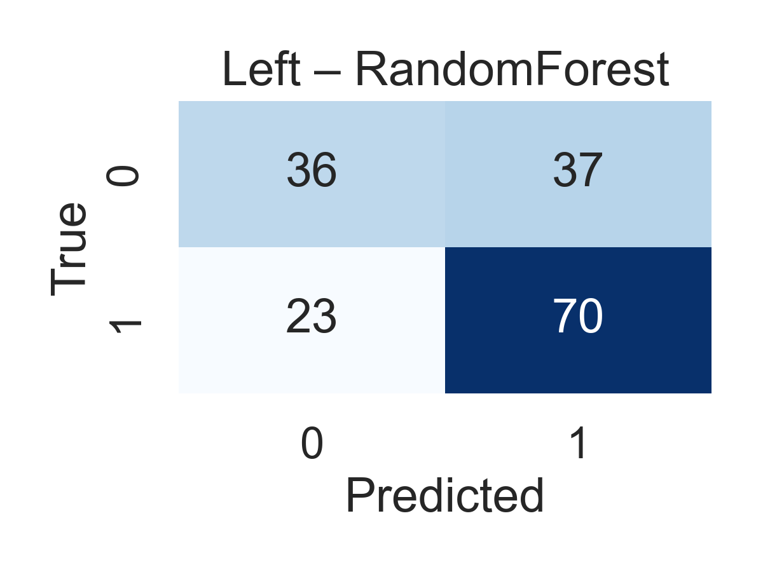
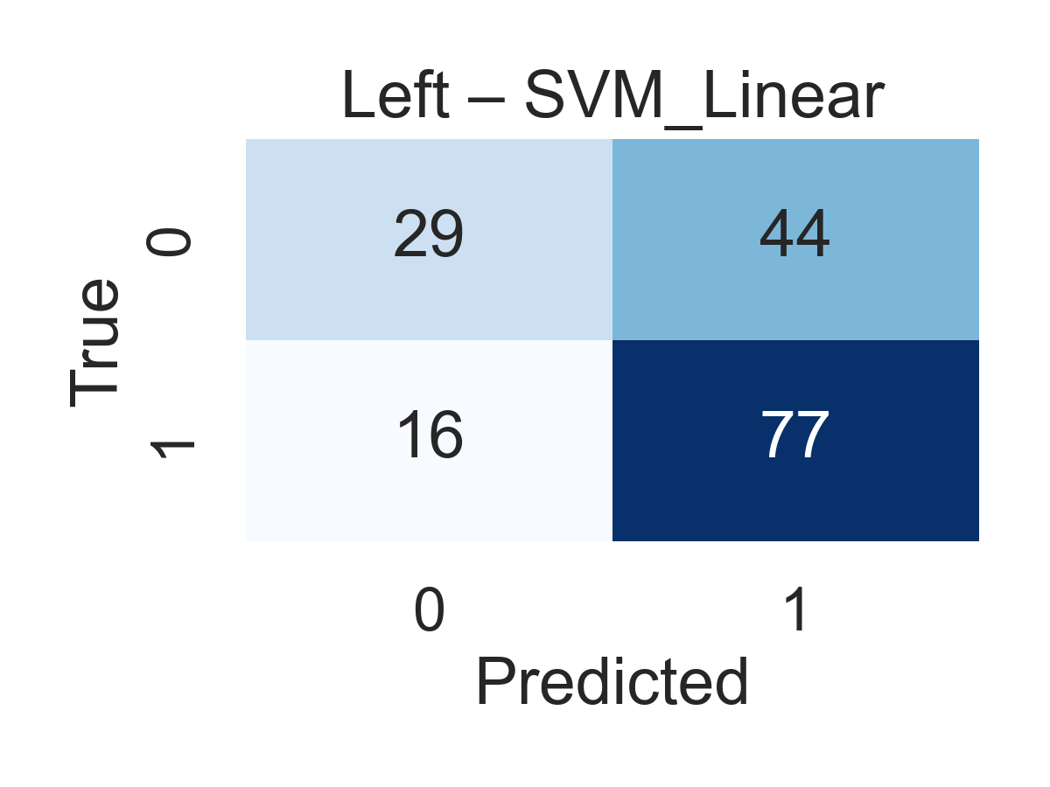
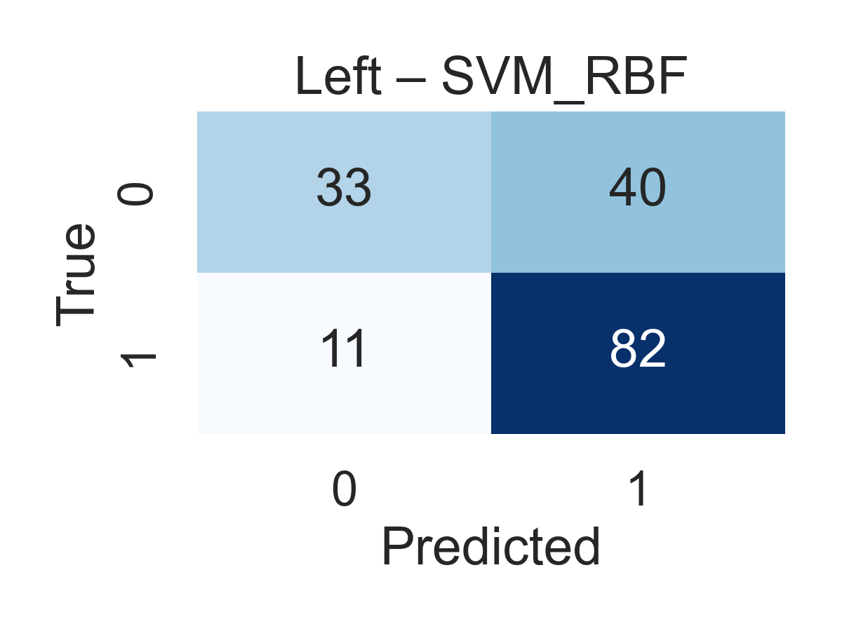
Left Foot – Confusion Matrices (5-Fold Aggregated)
Pooled out-of-fold predictions - each subject appears exactly once
High sensitivity (75%), low
specificity (49%) - biased toward PD
Highest FP count -
linear kernel fails gait complexity.
Best sensitivity (89%), specificity still weak (45%).
Takeaways:
Weakest feature set - no model exceeds 69% accuracy
High sensitivity (75–89%) but low specificity (40–49%) across all models
Left foot alone insufficient for reliable PD vs HC classification

Slide 15
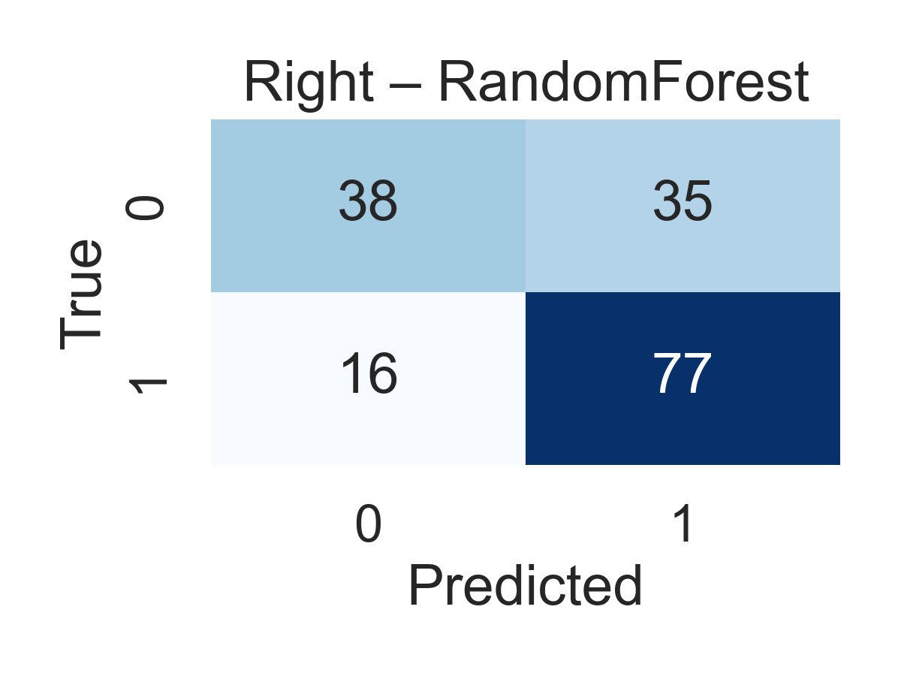
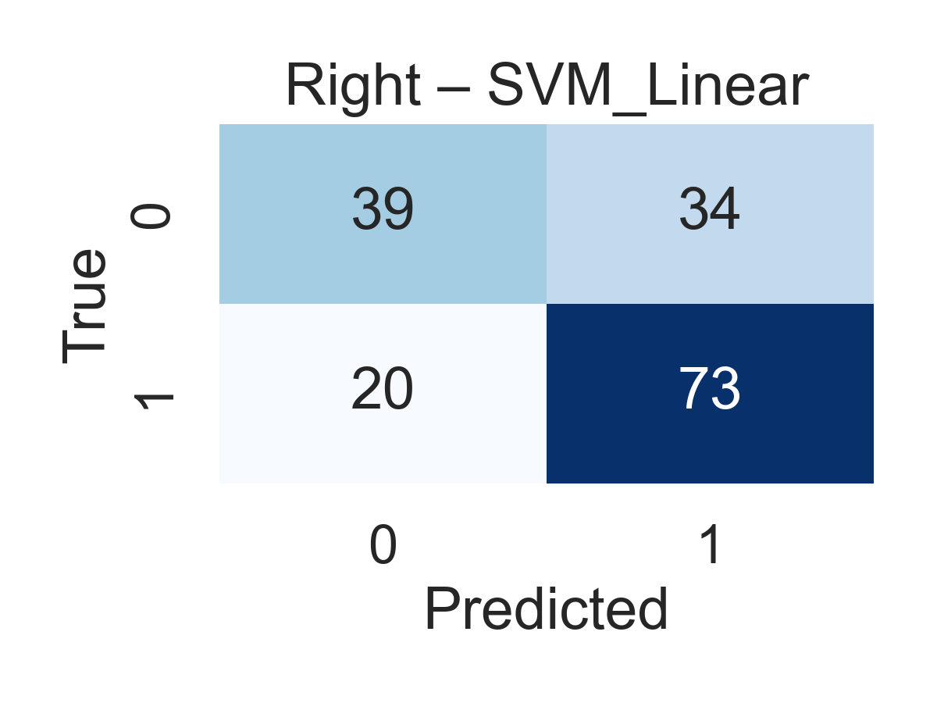
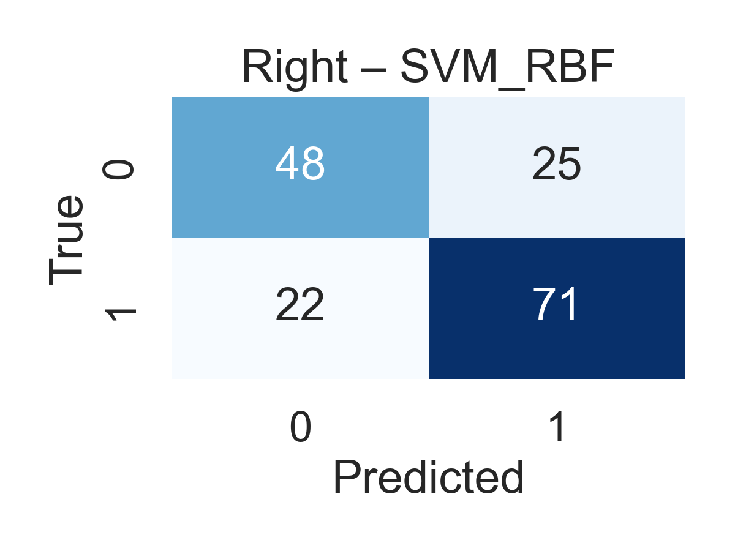
Right Foot – Confusion Matrices (5-Fold Aggregated)
Pooled out-of-fold predictions - each subject appears exactly once
83% sensitivity, 52% specificity - strong PD marker capture.
Similar sensitivity (78%) but decision boundary remains misaligned.
Best HC/PD balance — 76% sensitivity, 66% specificity.
Takeaways:
Strongest single-foot set - accuracy improves to 69–72%
SVM RBF best captures the non-linear boundary
SVM Linear consistently underperforms across all datasets

Slide 16
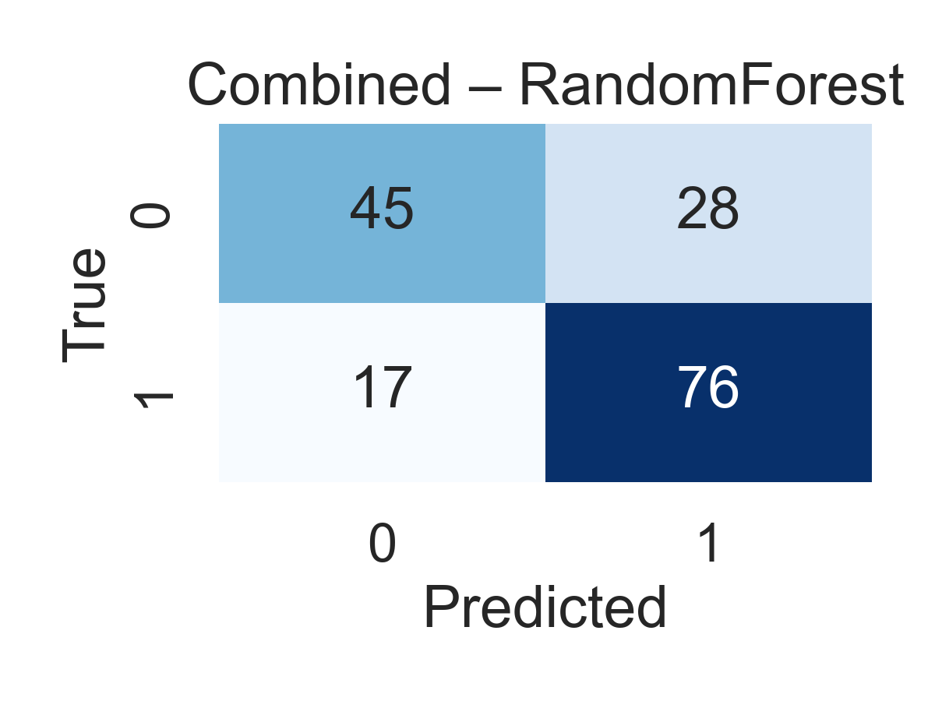
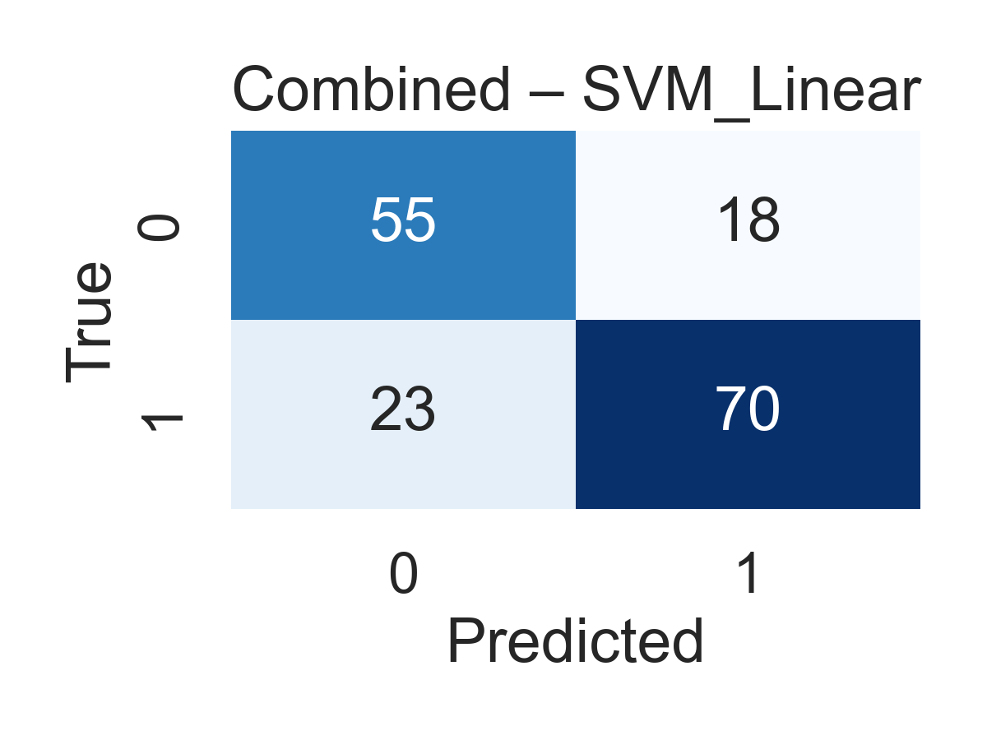
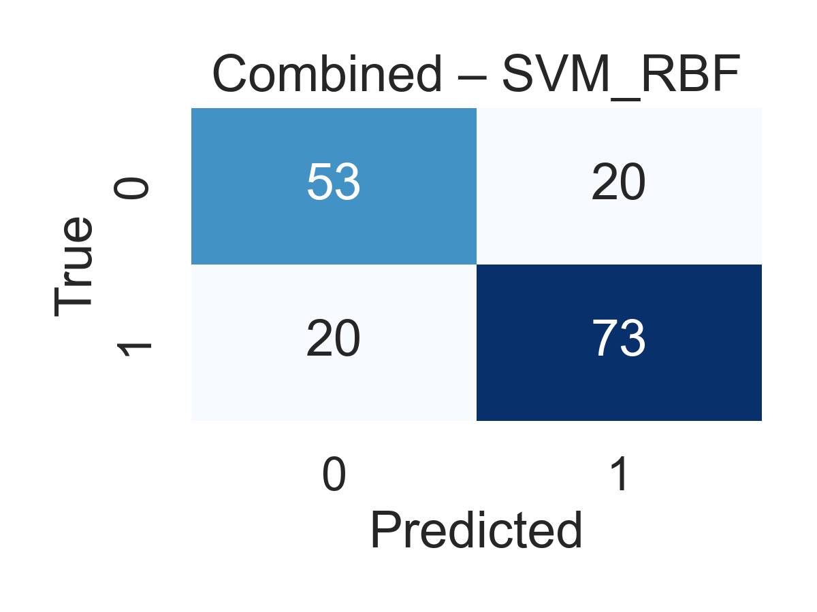
Combined Feet – Confusion Matrices (5-Fold Aggregated)
Pooled out-of-fold predictions - each subject appears exactly once
73% accuracy, 82% sensitivity, 62% specificity - robust bilateral integration.
Specificity reaches 75% -
bilateral features partially offset linearity.
Best overall - 78% sensitivity, 73% specificity.
Takeaways:
Combining both feet gives best results across all classifiers (73–78% accuracy)
SVM RBF achieves the strongest balance — only model where specificity meaningfully closes the gap
Bilateral gait asymmetry is the key discriminating signal

Slide 17
Conclusions, Limitations & Future Work
Summary · Key Findings · Next Steps
KEY CONCLUSIONS
LIMITATIONS
FUTURE DIRECTIONS
Right Foot > Left Foot -> clearer PD–HC separation, stronger discriminative patterns
Small dataset (n=166) — limits generalization to larger populations
Apply State Space Models (Mamba) to raw vGRF sequences
Combined bilateral features outperform single-foot across ALL classifiers
TSFresh aggregation loses temporal ordering of gait events
Explore LDA for supervised dimensionality reduction
Non-linear models (RF, SVM-RBF) best capture PD–HC gait differences
Left-foot specificity low (0.40–0.49) — possible HC compensation effect
Representation learning: Use self-supervised or deep embedding methods to learn richer gait signatures
TSFresh automation provides rich, reproducible features without manual design
Classical ML cannot model cross-foot coordination dynamically
Validate on larger multi-site PD gait datasets
BEST BASELINE — Combined + SVM-RBF (Nested CV)
78%
0.85
78%
72%
Accuracy
AUC
Sensitivity
Specificity
Unbiased estimate via 5-fold outer / 3-fold inner nested cross-validation · n=166
Notes:
OVERALL TAKEAWAY
Classical ML + TSFresh delivers solid, interpretable baseline above 75% accuracy threshold
Bilateral gait asymmetry is the key discriminative signal — both feet essential
Temporal modeling gap motivates Mamba / SSM for future sequence-based analysis

Slide 18

Any Questions ?
THANK YOU

